Slide 1
An Empirical Investigation into Learning Bug-Fixing Patches in the Wild via Neural Machine Translation
Michele Tufano, Cody Watson, Gabriele Bavota, Massimiliano Di Penta, Martin White, and Denys Poshyvanyk. 2018
Proceedings of the 2018 33rd ACM/IEEE International Conference on Automated Software Engineering (ASE ’18)
2019 /11/08
Ju Hyoung Kim

Slide 2
Contents
Abstract
Introduction
Approach
Experimental Design and Result
Threats to validity
Conclusions

Slide 3
Abstract
Millions of open-source projects with numerous bug fixes are available in code repositories.
This proliferation of software development histories can be leveraged to learn how to fix common programming bugs.
Perform an empirical study to assess the feasibility of using Neural Machine Translation techniques(NMT) for learning bug-fixing patches for real defects.
Abstract the buggy and corresponding fixed code, and use them to train an Encoder-Decoder model able to translate buggy code into its fixed version.

Slide 4
Introduction
Techniques either use a generate-and-validate approach,which consists of generating many repairs or an approach that produce a single fix
Two major problems automated repair approaches
1. Producing patches acceptable for programmers
2. Generate-and-Validate techniques ,over-fitting patches to test cases.
- To deal with
1.Leverage the past history of existing projects in terms of bug-fix patches and compare automatically-generated patches with existing ones.
2. Identifies patches from past fixes Prophet,which after having localized the likely faulty code by running test cases, generates patches from correct code using a probabilistic model

Slide 5
Introduction
Motivated three considerations.
1. Automated repair approaches are based on a relatively limited and manuallty-crafted set of transformations or fixing patterns.
2. Past history of existing projects can be successfully leveraged to understand what a”meaningful”program repair patch is.
3. Several works have recently demonstrated the capability of advanced machine learning techniques, such as deep learning, to learn from large software engineering datasets.

Slide 6
Introduction
Forge like GitHub provide a plethora of change history and bug-fixing
Machine learning based approach can leverage this data to learn about bug-fixing.
NMT-based approach for the task of automatically generating patches.
- Extract method-level AST -> identify multiple method-level differences per bug-fixing commit(independently consider) -> yielding to bug-fix pairs(BFPs) -> BFPs abstracted to make it more suitable for the NMT model ->encoder-decoder model (understand how the buggy code to fixed code)

Slide 7
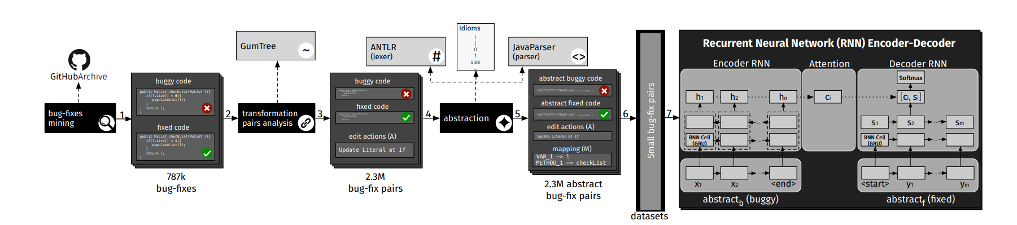
Approach

Slide 8
Approach 〮Bug-fixes Mining
Using github archive and google bigQuery APIs to identify all comits having a message containing the patterns (“fix”or”solve”) and(“bug”or”issue”or”problem”or”error”)
Two authors independently analyzed a statistically significant sample for Precision(real fixing check)
Extracted the source code before and after the bug-fix .
(collect the buggy and the fixed code)
Except non java failes, created bug fixing commit, more than five Java files
( Aim to learn focused bug-fixes Not spread across the system)

Slide 9
Approach 〮Bug-fixes pairs analysis (Extraction)
BFP(bug-fixing pair) = (mb,mf) = (buggy code,fixed code)
Use these BFPs to train the NMT model, learning the translation from buggy to fixed code for generating patches.
Separate the code into method-level
1.Methods represent a reasonable target for fixing activities, since they are likely to implement a single task or functionality.
2. Methods provide enough meaningful context for learning fixes.
3. Considering arbitrarily long snippets of code makes learning more difficult given the variability in size and context
L = {(m1b ,m1f ), . . . ,(mnb ,mnf )}. Mapped pairs of methods.

Slide 10
Approach 〮Bug-fixes pairs analysis(Extraction)
Extract a sequence of edit actions. output of this phase is a list of BFPs = {b f p1, . . . ,b f pk }
b f p = {mb ,mf ,A} (buggy method, fixed method, edit actions)
Exclude methods created/deleted during the fixing
- It should be noted that the process we use to extract the BFPs
1. does not capture changes performed outside methods
2. considers each BFP as an independent bug fix.

Slide 11
Approach 〮Bug-fixes pairs analysis(Abstraction)
Learning patterns challenging due to the huge vocabulary of terms
To deal with, abstract the code and generate an expressive yet vocabulary-limited representation.
Use a java lexer and a parser to represent each buggy and fixed method.
The Lexer, tokenizes the raw code into a stream of tokens, fed into a java parser, which discerns the role of each identifier and the type of a literal.
The parser generates and substitutes a unique ID for each identifier/literal within the tokenized stream. in case of multiple appear, mapping of identifiers/literals Same ID

Slide 12
Approach 〮Bug-fixes pairs analysis
- Bfpa = {abstractb,abstractf,A,M}
-M = ID mapping for particular BFP
Analyze the buggy code mb and corresponding fixed code mf
IDs are assigned to identifiers and literals in sequential
Method name : METHOD_1, METHOD_2, ect.
Variable name : VAR_X
Literals : (STRING_X, INT_X,FLOAT_X)
Abstractions are a stream of tokens consisting of language keywords(for,if) ,separators(“(“,”;”,”}”)
and IDs (identifiers and literals)
- Comments and annotations removed.

Slide 13
Approach 〮Bug-fixes pairs analysis
Some identifiers and literals appear so often, for our abstraction, can be treated as keywords of the language.
(variables I,j,or index used in loops, or literals such as 0,1,-1, used in conditional statements and return values)
Similarly, method name such as size or add, appear several times since they represent common concepts,
- These identifiers and literals are often referred to as “idioms”
- keep the original text when abstraction, not replace.
To define the list of idioms,
1. randomly sampled 300k BFPs and considered all their original source code.
2. extracted the frequency of each identifier/literal used in the code
3. discarding keywords,spearators,and comments
4. Analyze the distribution of the frequencies and focused on the top 0.005% words

Slide 14
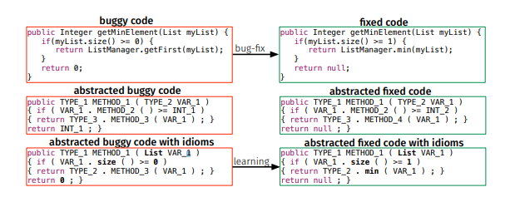
Approach 〮Bug-fixes pairs analysis
minimum value in a list of integers contains three errors
if-condition
getFirst method
Return value.

Slide 15
Approach 〮Bug-fixes pairs analysis
When we feed the buggy piece of code to the Java parser and Lexer, we identify some problems with the mapping.
.Abstracted fixed code contains INT_2 and METHOD_4, which are not contained in buggy code
Since the mapping of tokens to code is solely reliant on the buggy method, this example would require the synthesis of new values for INT_2 and METHOD_4.
Takes advantage of idioms, allowing to still consider this BFP.
- When using the abstraction with idioms, can replace tokens with the values they represent.
INT_2 -> idiom 1
METHOD_4 -> idiom min

Slide 16
Approach 〮Bug-fixes pairs analysis (Filtering)
Filter out BFPs that
Contain lexical or syntactic errors (either the lexer or parser fails to process them)
Buggy and fixed abstracted code resulted in equal strings
Performed more than 100 atomic AST actions
(To eliminate outliers of the distribution, which could hinder the learning process)
Filter the BFPs based on their size, measured in the number of tokens.
Disregard long methods(longer than 50 tokens)

Slide 17
Approach 〮Bug-fixes pairs analysis (Synthesis of Identifiers and Literals)
The buggy code abstractb is used as input to the model, which is trained to output the corresponding fixed code abstractf.
This output can mapped back to real source code using M
In real usage scenario,
1.when model is deployed, we do not have access to the oracle ,but only to the input code
2. This code can be abstracted and fed to the model, which generates as output a predicted code(abstractp).
The IDs that the abstractp contains can be mapped back to real values only if they also appear in the input code.

Slide 18
Approach 〮Learning patches
Dataset preparations
b f pa = {abstractb , abstractf ,A, M}
1. Use only (abstractb,abstractf)= abstracted code for learning
2. A is possible fixing action provided during the learning process
3. training(80%), validation(10%), test(10%) sets.
4. Remove any duplicated pairs(asbstractf,abstractb)b) to not bias the result

Slide 19
Approach 〮Learning patches
NMT
Experimented model is based on RNN encoder-decoder architecture, adopted in NMT
Encodes a sequence of terms x into a vector representation, Decodes the representation into another sequence of terms.
X=abstractb=(x1,…,xn) y = abstractf =(y1,…,ym)
Encoder-Decorder model with attention mechanism.

Slide 20
Approach 〮Learning patches
Encoder-Decoder model with attention mechanism.
1. Encoder takes as input sequence x=(x1,…,Xn)
2. Sequence of states h = (h1,…,hn)
3. rely on a bi-directional RNN encoder(backward forward)
(which are able to create representations taking into account both past and future inputs.
hi = concatenation of the state produced by the two RNNs
4. Decoder predicts the probability of a target sequence
based on – recurrent state si
- previous i-1 terms(y1,…,yi-1)
- context vector Ci ( attention mechanism)
weights ait allow the model to pay more attention to different parts of the input sequence How much the term xi should be taken into account when predicting the target term

Slide 21
Approach 〮Learning patches
Hyperameter Search
For the model performed hyperparamet search by testing ten configurations different combinations of RNN Cells (LSTM [13] and GRU [6]), number of layers (1, 2, 4) and units (256, 512) for the encoder/decoder, and the embedding size (256, 512)
Bucketing and padding.
60k epochs selected the model`s checkpoint before over-fitting
To guide the best configuration, loss function computed on the validation set, results are computed on the test set.

Slide 22
Experimental design and Result
RQ : Is Neural Machine Translation a viable approach to learn how to fix code?
- Aim to empirically assessing whether NMT is a viable approach to learn transformations of the code from a buggy to a fixed state
-when performing the hyperparameter search, found that the configuration which achieved the best results on the validation set was
the one with 1-layer bi-directional Encoder, 2-layer Attention Decoder both with 256 units, embedding size of 512, and LSTM [13] RNN cells. We trained the M small model for 50k epochs.

Slide 23
Experimental design and Result
Successfully generate a fix for 538 out of 5,835 cases (9.22%)
While the successful fixes might appear relatively small
But these fixes are generated with a single guess of the model as opposed to previous approaches that generate many potential patches.

Slide 24
Threats to validity
Construct validity : To mitigate imprecisions in our datasets, we manually analyzed a sample
Internal : Possible that the performance of our model depends on the hyperparameter configuration.
External : Did not compare NMT models with state-of-the-art techniques related with automatic program repair

Slide 25
Conclusions.
Presented an empirical investigation into the applicability of NMT for the purpose of learning how to fix code, from real bug-fixes.
1.Devised and detailed a process to mine,extract,and abstract the source code(BFP)
2. Set up ,trained, tuned NMT models to translate buggy code into fixed code.
3. Found that model is able to fix a large number of unique bug-fixes

